Slide 1
First:
Watch Introduction Video from the Social Studies Department Clayton County before starting PowerPoint. Click video with mouse until white play bar comes up below.

Slide 2
Second: SIGN IN
Teachers will sign in with the correct QR Code on the next few slides.
Make sure you are signing in on the correct session. There is a slide for each session, so forward the slides until you are on the correct session.
LAST: At the end of the PP is a SIGN OUT slide for each session. This is a MUST DO!

Slide 3
County Sign In Session 1
Please sign in for county documentation.

Slide 4
County Sign In Session 2
Please sign in for county documentation.

Slide 5
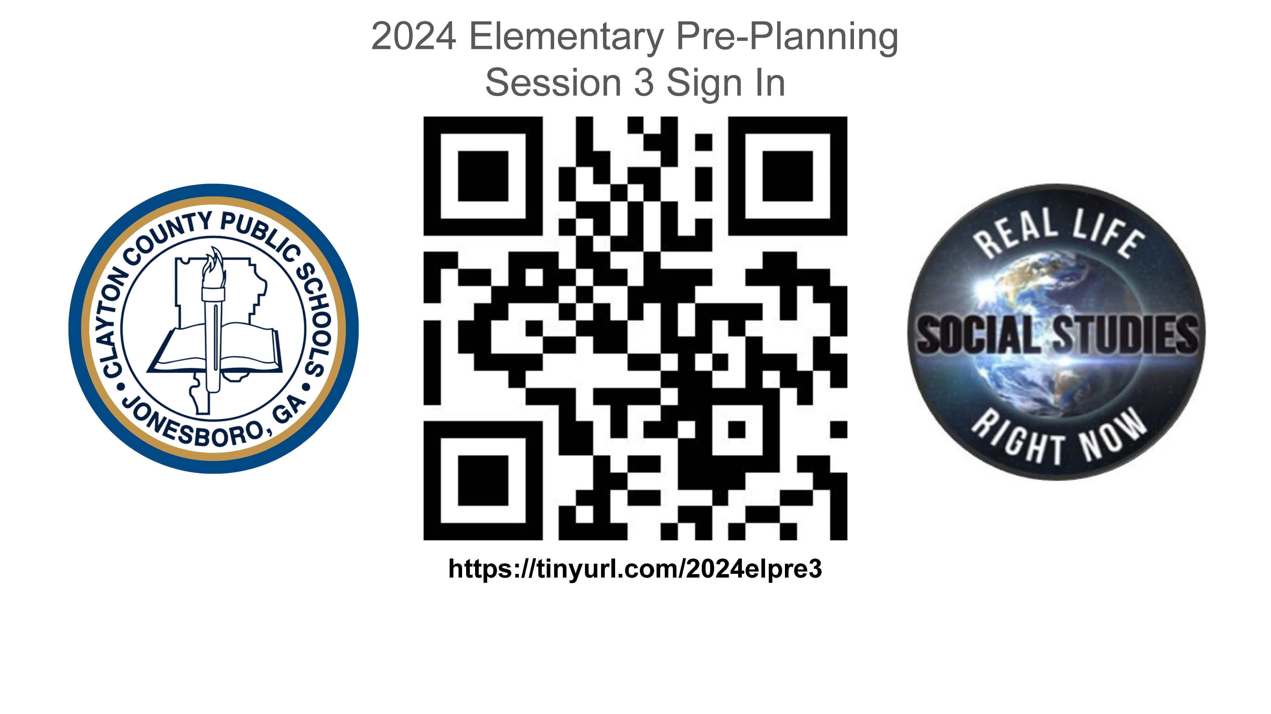
County Sign In Session 3
Please sign in for county documentation.

Slide 6
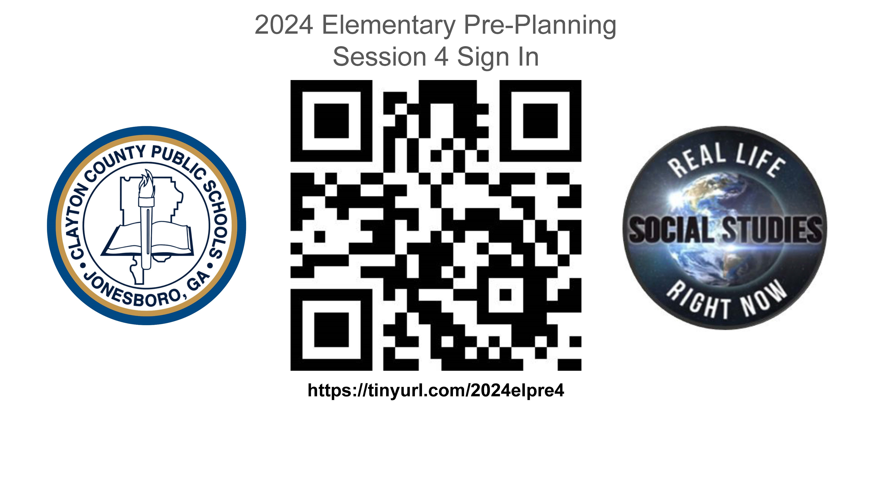
County Sign In Session 4
Please sign in for county documentation.

Slide 7
Start Slideshow after watching Introduction Video from Clayton County and Sign In for the session is completed.

Slide 8
A student engaging and teacher-friendly Georgia curriculum!
Science of Reading
Social Studies
Presentation
for Clayton County School System
Second Grade

Slide 9
About Concise Curriculum
Fully Aligned to GA Social Studies and ELA Standards
Who we are and why our products work:
Concise Curriculum is a women-owned business that was started by two teachers with over 70 yrs. combined experience. Our texts were created to allow teachers and students additional time focusing on reading skills in content subject areas using an integrated, consistent curriculum.
Promotes engaged student learning & builds Lexile Levels!
Concise Curriculum Supports the Science of Reading Research

Slide 10
Concise Curriculum is formatted to support different learning styles.
Concise Curriculum is understandable,
accessible, engaging, and beneficial to all learners.
Concise Curriculum Supports the Science of Reading Research

Slide 11
Today’s objective

Slide 12
What is today’s objective?
Take an early break or
Build better readers
Concise Curriculum Supports the Science of Reading Research

Slide 13
Objective:
Concise Curriculum Supports the Science of Reading Research

Slide 14
Objective:
Concise Curriculum Supports the Science of Reading Research

Slide 15
Objective:
Concise Curriculum Supports the Science of Reading Research
This Photo by Unknown Author is licensed under CC BY-SA

Slide 16
What is today’s objective?
Build Better Readers
Concise Curriculum Supports the Science of Reading Research

Slide 17
We can build better readers by integrating ELA standards with existing Social Studies standards.
Concise Curriculum Supports the Science of Reading Research

Slide 18
How does Concise Curriculum support the Science of Reading Research?
Concise Curriculum Supports the Science of Reading Research

Slide 19
Social Studies texts that support the Science of Reading!
vocabulary development
reading comprehension
background knowledge
fluency practice and decoding
meaningful content
Concise Curriculum Supports the Science of Reading Research

Slide 20
The science of reading is not only applicable during the “Reading Block”- Science and Social Studies texts support the Science of Reading in the Content Areas.
Concise Curriculum Supports the Science of Reading Research

Slide 21
Left Right Activity
Let’s Move Around!
Please stand by your desk.
Think about your current knowledge of the Science of Reading.
Concise Curriculum Supports the Science of Reading Research

Slide 22
Think About These Questions:
Concise Curriculum Supports the Science of Reading Research

Slide 23
Do you know what the science of reading is?
Are you comfortable explaining the science of reading? (somewhat of an expert)
Are you comfortable implementing the science of reading in your classroom?
Concise Curriculum Supports the Science of Reading Research

Slide 24
Let’s Move Around!
If you are comfortable/expert with your knowledge of the Science of Reading, please stand on the left side of the room.
If you are a novice in the Science of Reading, please stand on the right side of the room.
If you are somewhere in the middle, please stand in the middle of the room.
Concise Curriculum Supports the Science of Reading Research

Slide 25
Let’s Move Around!
EXPERT MIDDLE NOVICE
Concise Curriculum Supports the Science of Reading Research

Slide 26
Let’s Move Around!
Ask one person in each group (comfortable (expert), middle, and novice) to share their thoughts on how comfortable they are with the SOR and why.
Concise Curriculum Supports the Science of Reading Research

Slide 27
Our GOAL for TODAY
Our goal is to “move” people from
the right side of the room (novice) to the
left side of the room (expert), by the end
of today’s Professional
Learning .

Slide 28
Topics for Today
The Simple View of Reading
The Science of Reading
Scarborough’s Rope
How Concise Curriculum supports the Science of Reading
The Writing Rope

Slide 29
The Simple View of Reading

Slide 30
Let’s start with the Simple View of Reading (SVR)
The aim of learning to read is COMPREHENSION.
What is comprehension?

Slide 31
What is comprehension?
Comprehension is the ability to extract meaning from print.

Slide 32
extract meaning from print = understanding what you read

Slide 33
Calling words is NOT understanding

Slide 34
Calling words is NOT understanding

Slide 35
Think about your classroom: you may have some students who can “call the words”, but when asked a question about what they’ve read they draw a blank. They are not comprehending.
Actual reading = comprehension

Slide 36
Simple View of Reading
R = D x LC
Reading comprehension =
decoding x linguistic comprehension

Slide 37
Reading comprehension =
DECODING includes Ciphering Knowledge
(letter-sound knowledge, orthographic knowledge, phonological awareness, rapid automatized naming)

Slide 38
Ciphering Knowledge
letter-sound knowledge
orthographic knowledge
phonological awareness
rapid automatized naming

Slide 39
Reading comprehension =
Word-Specific Knowledge (sight word memory, orthographic knowledge, phonological long-term memory)
orthographic – the representation of sounds in a language by written or printed symbols

Slide 40
LINGUISTIC COMPREHENSION
LANGUAGE SKILLS Vocabulary/Semantic Knowledge, Grammatical/Syntactic Knowledge Inferencing Visual Spatial Skills
Semantics = the study of meaning in language – it can apply to a single word or many words
Syntax = the arrangement of words to create well-formed sentences

Slide 41
LINGUISTIC COMPREHENSION
ATTENTION Comprehension Monitoring
BACKGROUND KNOWLEDGE
WORKING MEMORY

Slide 42
LINGUISTIC COMPREHENSION
ATTENTION Comprehension Monitoring
Self Monitoring Strategies for Comprehension
Monitoring your comprehension is one of the best ways for someone to improve their reading comprehension.

Slide 43
LINGUISTIC COMPREHENSION
ATTENTION Comprehension Monitoring
Self Monitoring Strategies for Comprehension
Self questioning – one of the best ways to improve comprehension is through self-questioning

Slide 44
LINGUISTIC COMPREHENSION
ATTENTION Comprehension Monitoring
Self Monitoring Strategies for Comprehension
Reread the passage – this helps clarify thoughts and
fill in information gaps

Slide 45
LINGUISTIC COMPREHENSION
ATTENTION Comprehension Monitoring
Self Monitoring Strategies for Comprehension
Retell and rephrase the story

Slide 46
The Science of Reading

Slide 47
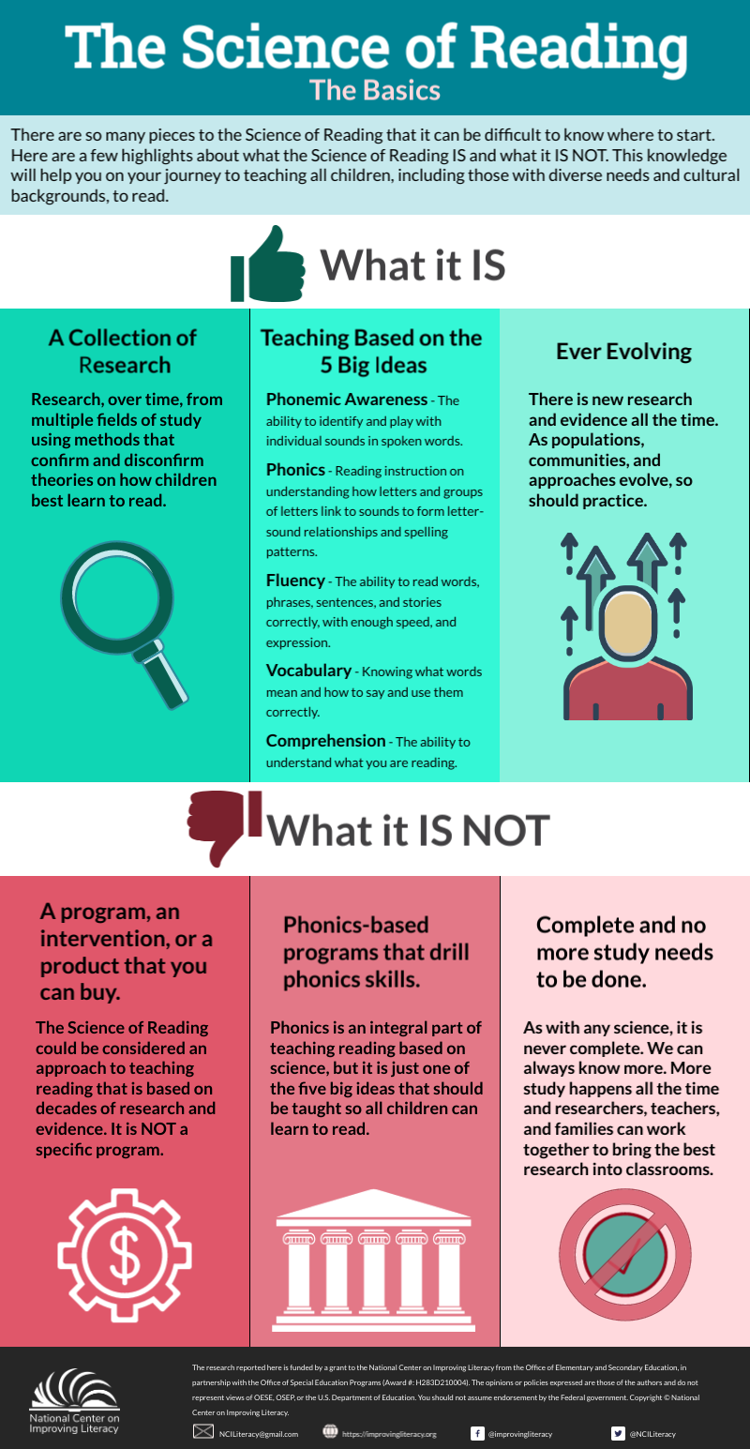
The Science of Reading
National Center on Improving
Literacy
*This is a very popular graphic you may have seen recently.
National Center on Improving Literacy (2022). The Science of Reading: The Basics. Washington, DC: U.S. Department of Education, Office of Elementary and Secondary Education, Office of Special Education Programs, National Center on Improving Literacy. Retrieved from http://improvingliteracy.org.

Slide 48
The Science of Reading National Center on Improving Literacy
*this is a very popular graphic you may have seen in the last year or two.
National Center on Improving Literacy (2022). The Science of Reading: The Basics. Washington, DC: U.S. Department of Education, Office of Elementary and Secondary Education, Office of Special Education Programs, National Center on Improving Literacy. Retrieved from http://improvingliteracy.org.
a collection of research
teaching based on the five big ideas
ever-evolving

Slide 49
Let’s listen to what the experts say about the science of reading. (video may be blocked – go ahead to next slide if so…)
https://youtu.be/cnkJ6VvDr2M

Slide 50
Important Takeaways from the Video
D x LC = RC
You can never have better reading comprehension than there is decoding or linguistic comprehension.
As Language Comprehension strands become more fully developed those skills are becoming more automatic. The same occurs with decoding.

Slide 51
Important Takeaways from the Video
D x LC = RC
Most of our knowledge generally comes from research – summaries of research, pedagogy, etc.
We need to look at the study of thinking and learning.
- the development of knowledge networks
- the kinds of practices that promote learning
Understanding how people learn, helps us understand how we can best teach people to learn to read.

Slide 52
Important Takeaways from the Video
Neuroscience – the study of the structure and function of the brain – which areas are activated and inactivated during reading
different parts of the brain are involved in the process of reading
the brain change as students have the proper reading instruction

Slide 53
What SOR is…

Slide 54
a collection of research
research over time from multiple fields of study (that confirm and disconfirm) how students learn to read

Slide 55
teaching based on the five big ideas

Slide 56
THE FIVE BIG IDEAS (Five from Five, 2020)
Phonemic Awareness
Phonics
Fluency
Vocabulary
Comprehension

Slide 57
Phonemic awareness(identifying sounds)
the ability to identify and play with individual sounds in spoken words
(rhyming, segmenting)

Slide 58
Phonics (connecting sound to print)
understanding how letters and groups of letters connect to sounds to form letter sound relationships quick /kw/

Slide 59
Fluency (reading with speed, accuracy, and expression)
the ability to read words, phrases, sentences and stories correctly with enough speed and expression

Slide 60
Vocabulary (word meanings)
knowing what words mean and how to say and use them correctly

Slide 61
Comprehension (understanding)
the ability to understand what you are reading

Slide 62
ever-evolving

Slide 63
ever-evolving
There is new research all the time related to how children learn to read. We should all be open to the review and implementation of new ideas if it’s in the best interest of children.

Slide 64
What SOR is NOT…
a single program or intervention

Slide 65
What SOR is NOT…
a single program or intervention

Slide 66
What SOR is NOT…
a phonics-based program that DRILLS phonics

Slide 67
What SOR is NOT…
a phonics-based program that DRILLS phonics

Slide 68
What SOR is NOT…
complete and no more study needs to be done

Slide 69
What SOR is NOT…
complete and no more study needs to be done

Slide 70
We AGREE that the SOR is NOT a single program or intervention….

Slide 71
HOWEVER,
Since we CAN SUPPORT the SOR research in Social Studies classes (non-fiction reading of the standards), we SHOULD!!!

Slide 72
HOWEVER,
Since we CAN SUPPORT
the SOR research in Social Studies classes (non-fiction reading of the standards), we SHOULD!!!

Slide 73
What is Scarborough’s rope?
Think about the following question…

Slide 74
Which rope below would you rather use for support on a hiking/climbing trip?

Slide 75
I would choose the rope that is wound tightly and not frayed.
What about you?

Slide 76
What is Scarborough’s Rope?

Slide 77
Many Strands Are Woven into Skilled Reading

Slide 78
What is Scarborough’s Rope?
Language Comprehension
Activate background knowledge
Vocabulary
Language Structures
Verbal Reasoning
Literacy Knowledge

Slide 79
What is Scarborough’s Rope?
Word Recognition
Phonological Awareness
Decoding
Sight Recognition

Slide 80
What is Scarborough’s Rope?
https://www.youtube.com/watch?v=NH81N_wsn9I

Slide 81
6-10 words about the Science of Reading
In 6 to 10 words write down what you now know about the Science of Reading.
Discuss your 6-10 word writing with your elbow/shoulder partner.
Did any of your thoughts change after watching the videos?
Did the videos clear up any misconceptions?
*Take a few minutes to ask a few teachers in the class to share their thoughts.

Slide 82
Program Components
Student Book
(non-reproducible book)
Teacher’s Guide, Answer Key for student book, and Assessment Guide (USB Flash drive)
Log-In for teachers to project flip books on their Smart Board or computer
(free with district purchase)

Slide 83
How does
Concise Curriculum support
the Science of Reading?

Slide 84
Making Connections
How does Concise Curriculum support the Science of Reading?

Slide 85
Making Connections
Each Concise Curriculum lesson builds background knowledge while students read and interact with meaningful content.
Second Grade SS/ELA Standards

Slide 86
Making Connections
Preview vocabulary

Slide 87
Making Connections
ELA Skills
Phonics
Reading Comprehension
Fluency

Slide 88
Let’s Go Through a Sample Lesson!
Remember each lesson supports the research of the SOR while integrating the GA Social Studies/ELA standards.
Jimmy Carter pages 98-111

Slide 89
Building Background Knowledge
Jimmy Carter pages 98-111
Think about the following questions as if you were asking your students to build background knowledge.

Slide 90
Building Background Knowledge
Do you know there was a President of the United States who was from Georgia?
Do you know his name?
This Photo by Unknown Author is licensed under CC BY-SA

Slide 91
Building Background Knowledge
Jimmy Carter pages 98-111
The former POTUS from Georgia is Jimmy Carter.
At this writing he is still alive and living in Georgia.
Many students might respond they have never heard of a president from Georgia. Jimmy Carter was president before their parents were born.

Slide 92
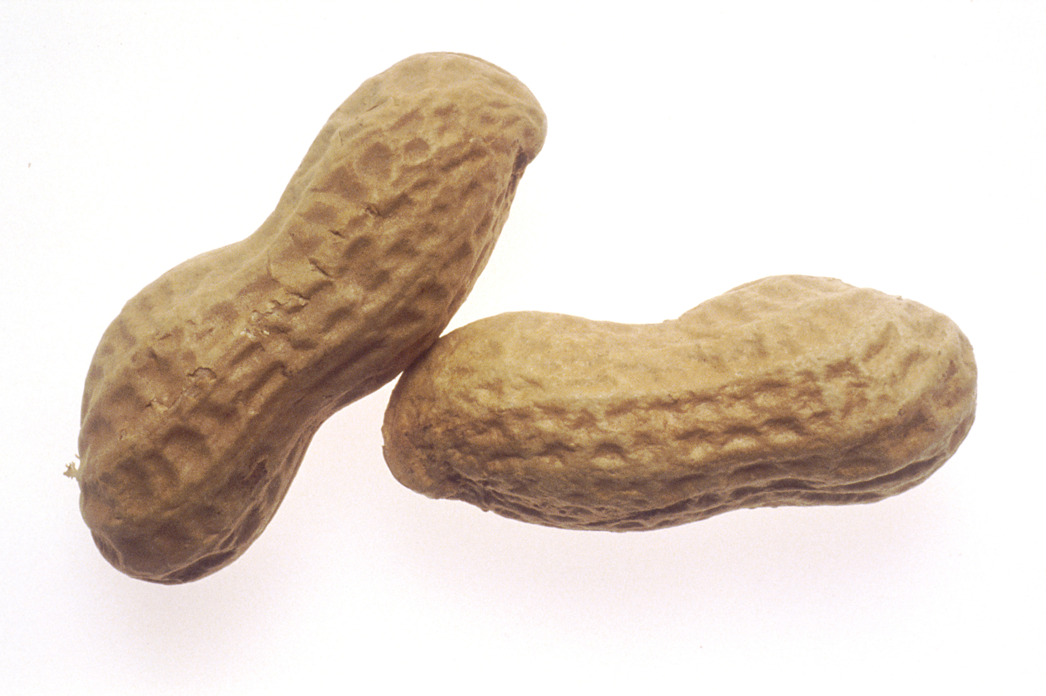
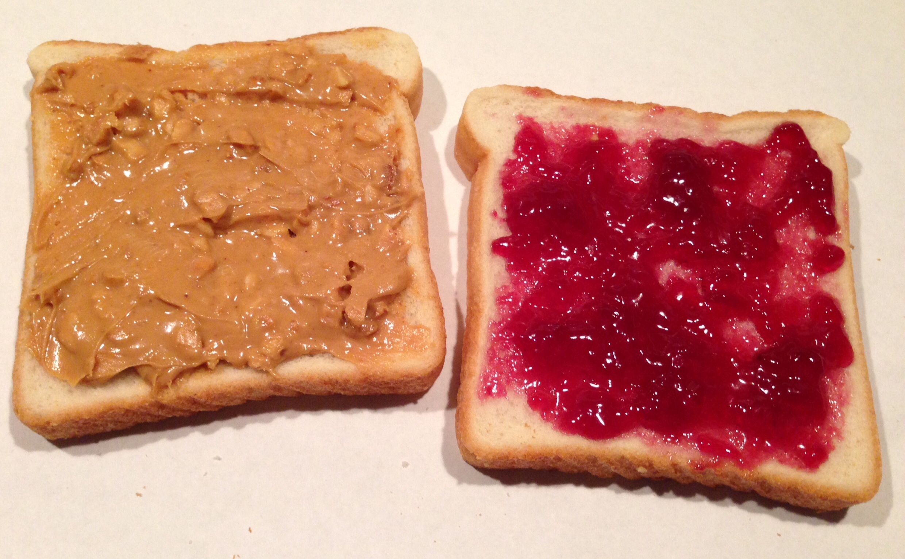
Building Background Knowledge
Jimmy Carter pages 98-111
Do any of you like peanut butter?

Slide 93
Building Background Knowledge
Jimmy Carter pages 98-111
Do any of you like peanut butter?
This question may lead to a discussion of peanut butter and if students like or dislike the taste of peanut butter.
This question builds an interest in peanuts and peanut butter which leads into learning about Jimmy Carter who was a peanut farmer in Georgia before becoming governor and then president in the 1970s.

Slide 94
Building Background Knowledge
Jimmy Carter pages 98-111
Concise Curriculum meets the requirements of the GA Social Studies Standards. Non-fiction texts are more rigorous than fiction texts. Teachers will read and reread the text with students. Reading and rereading helps clarify thoughts and fill in information gaps for the reader.

Slide 95
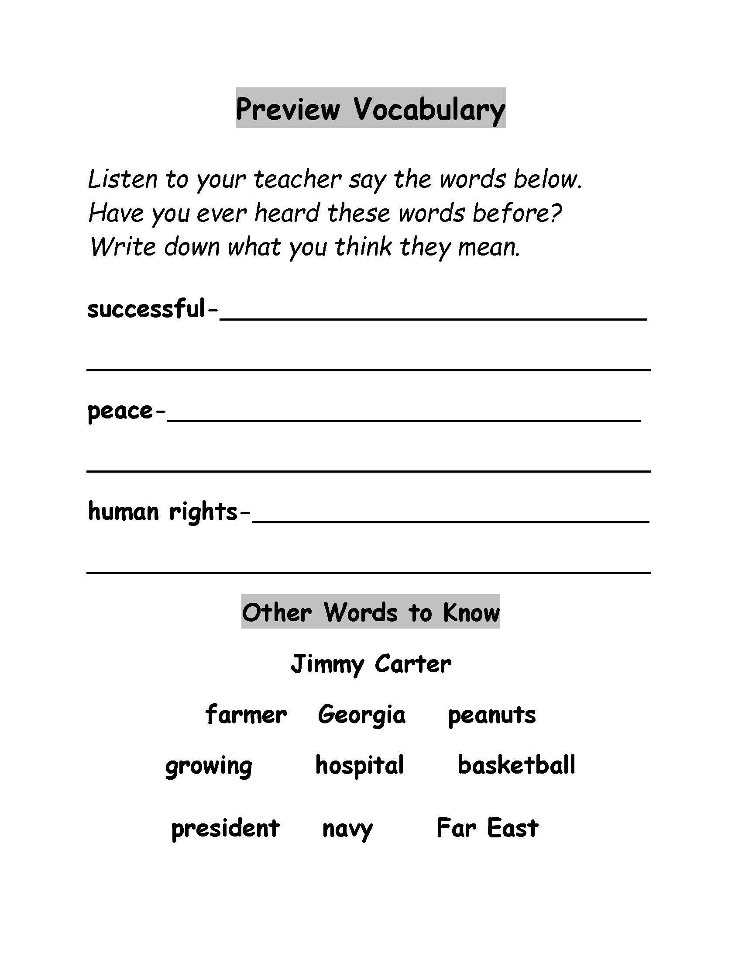
Vocabulary
A great way to activate prior knowledge is to ask students to write down what they think each vocabulary word for the preview means. This helps the teacher to determine which students have prior knowledge of the lesson vocabulary words. This also activates the students’ brains as they think about each word.

Slide 96
Vocabulary
The students will also draw a picture to help remember what each word means.
successful – this may be difficult to draw – students should think of something they are successful at and draw a picture of that activity
peace – the students could draw a peace symbol, or draw something that makes them feel peaceful (the teacher would want to talk about peace between countries – the students may say things like “peace is when you are not at war”
human rights – teacher led discussion

Slide 97
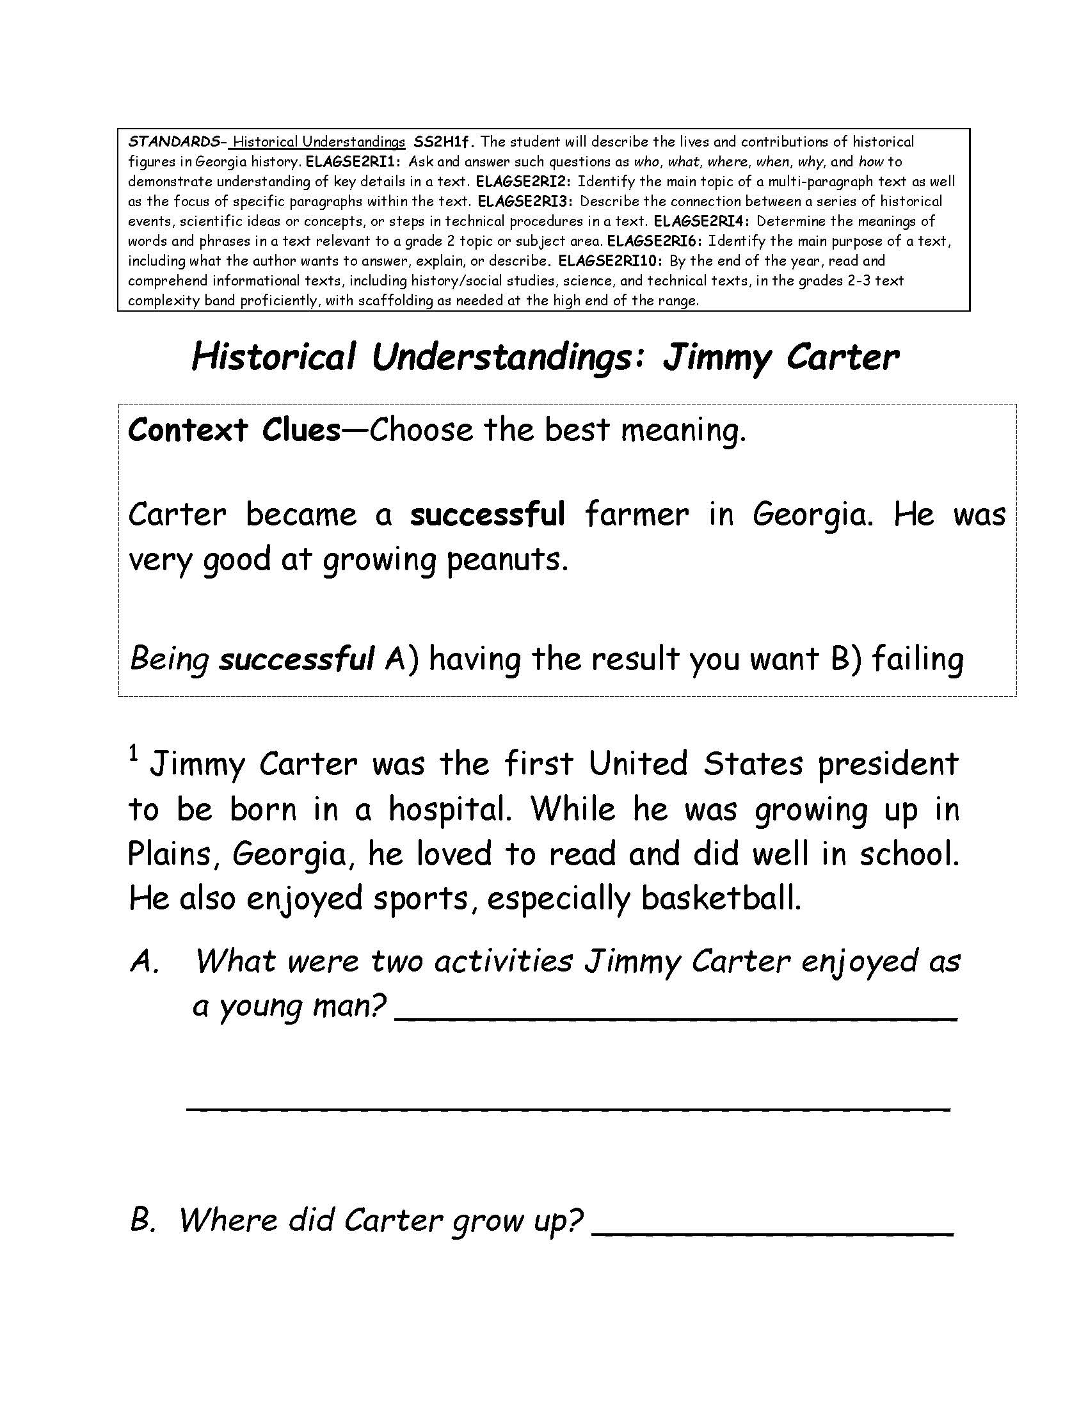
Reading Comprehension
Context Clues: very good is the clue in the sentence for the meaning of the word “successful”
Question A – students can locate in the text and underline the answer and then write the answer on the line.
Question B – Students can also underline or circle the answer in the text.
Students are learning relevant information about Social Studies standards/concepts while learning how to understand printed text/words.

Slide 98
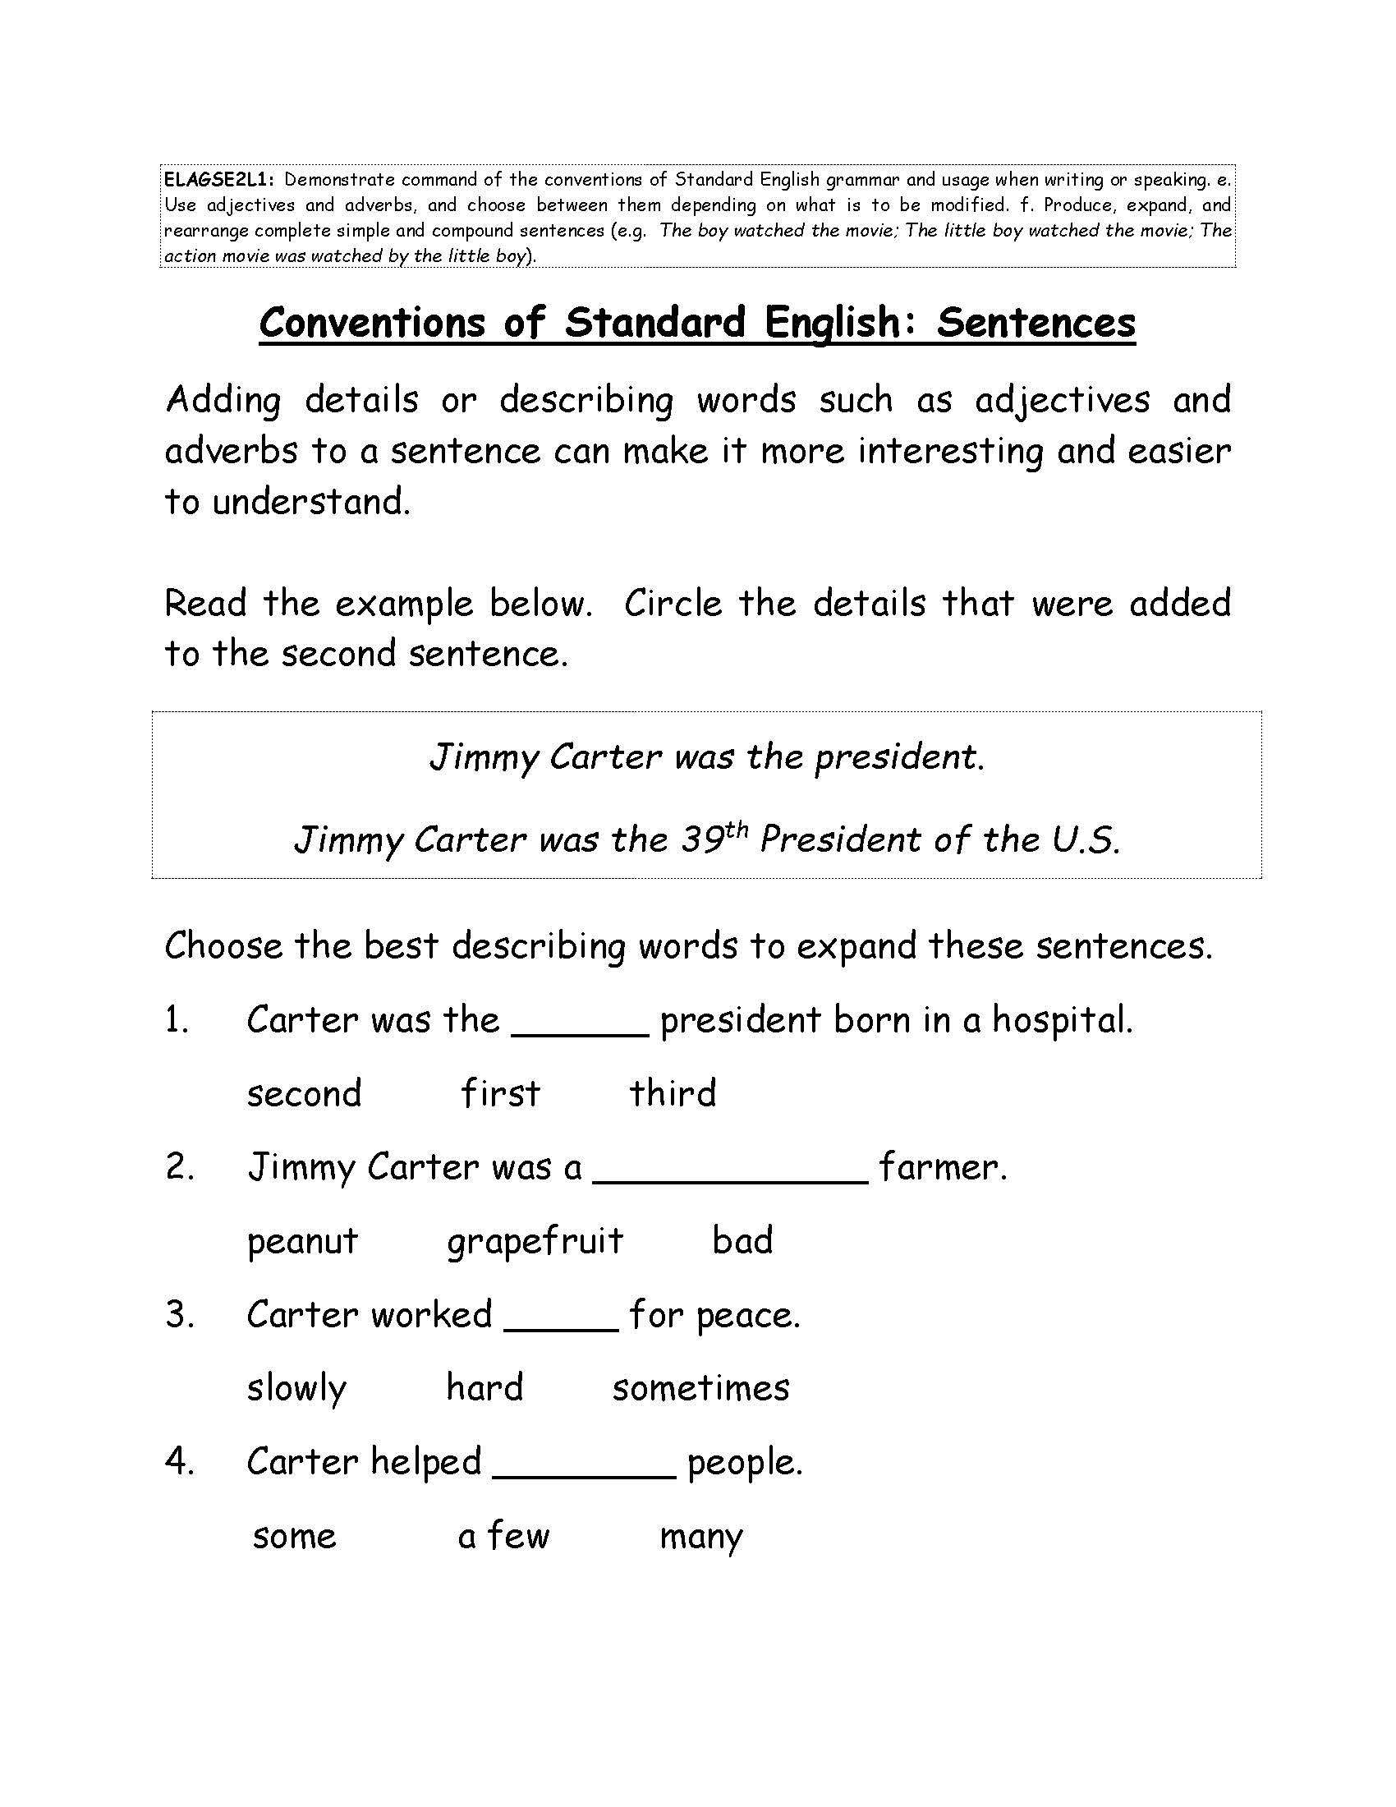
Conventions
This supports the
SYNTAX strand of the
Simple View of Reading –
students need to be
able to form
coherent, complete
sentences.

Slide 99
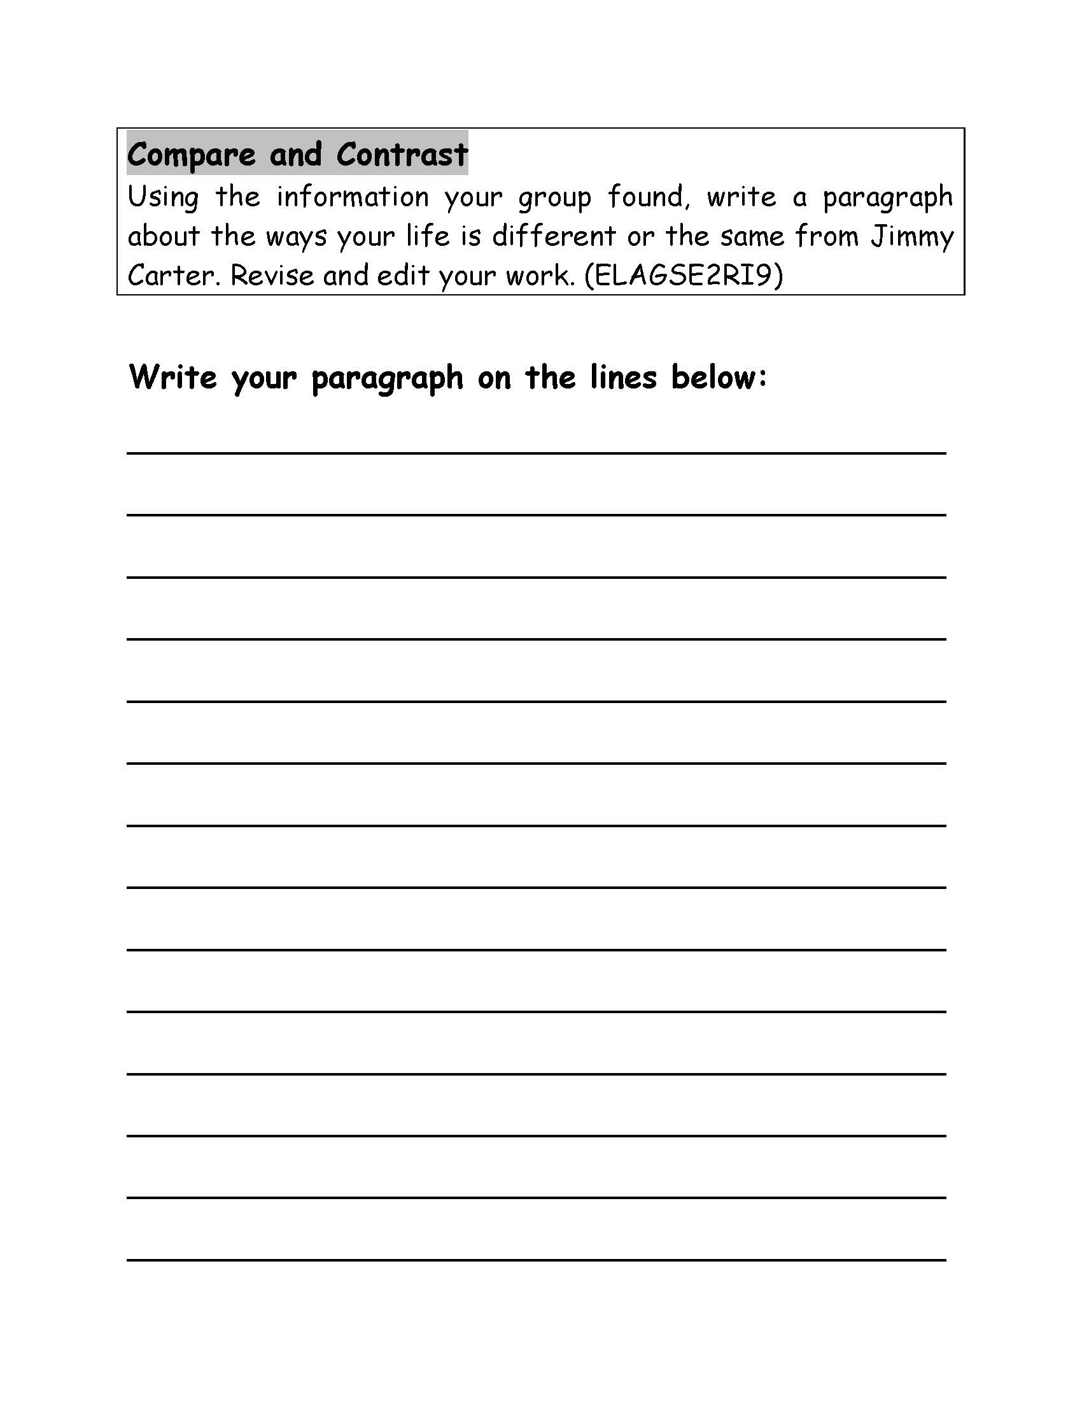
Compare and Contrast
See the compare and contrast writing activity
to compare and contrast the students’ lives with the life of Jimmy Carter.

Slide 100
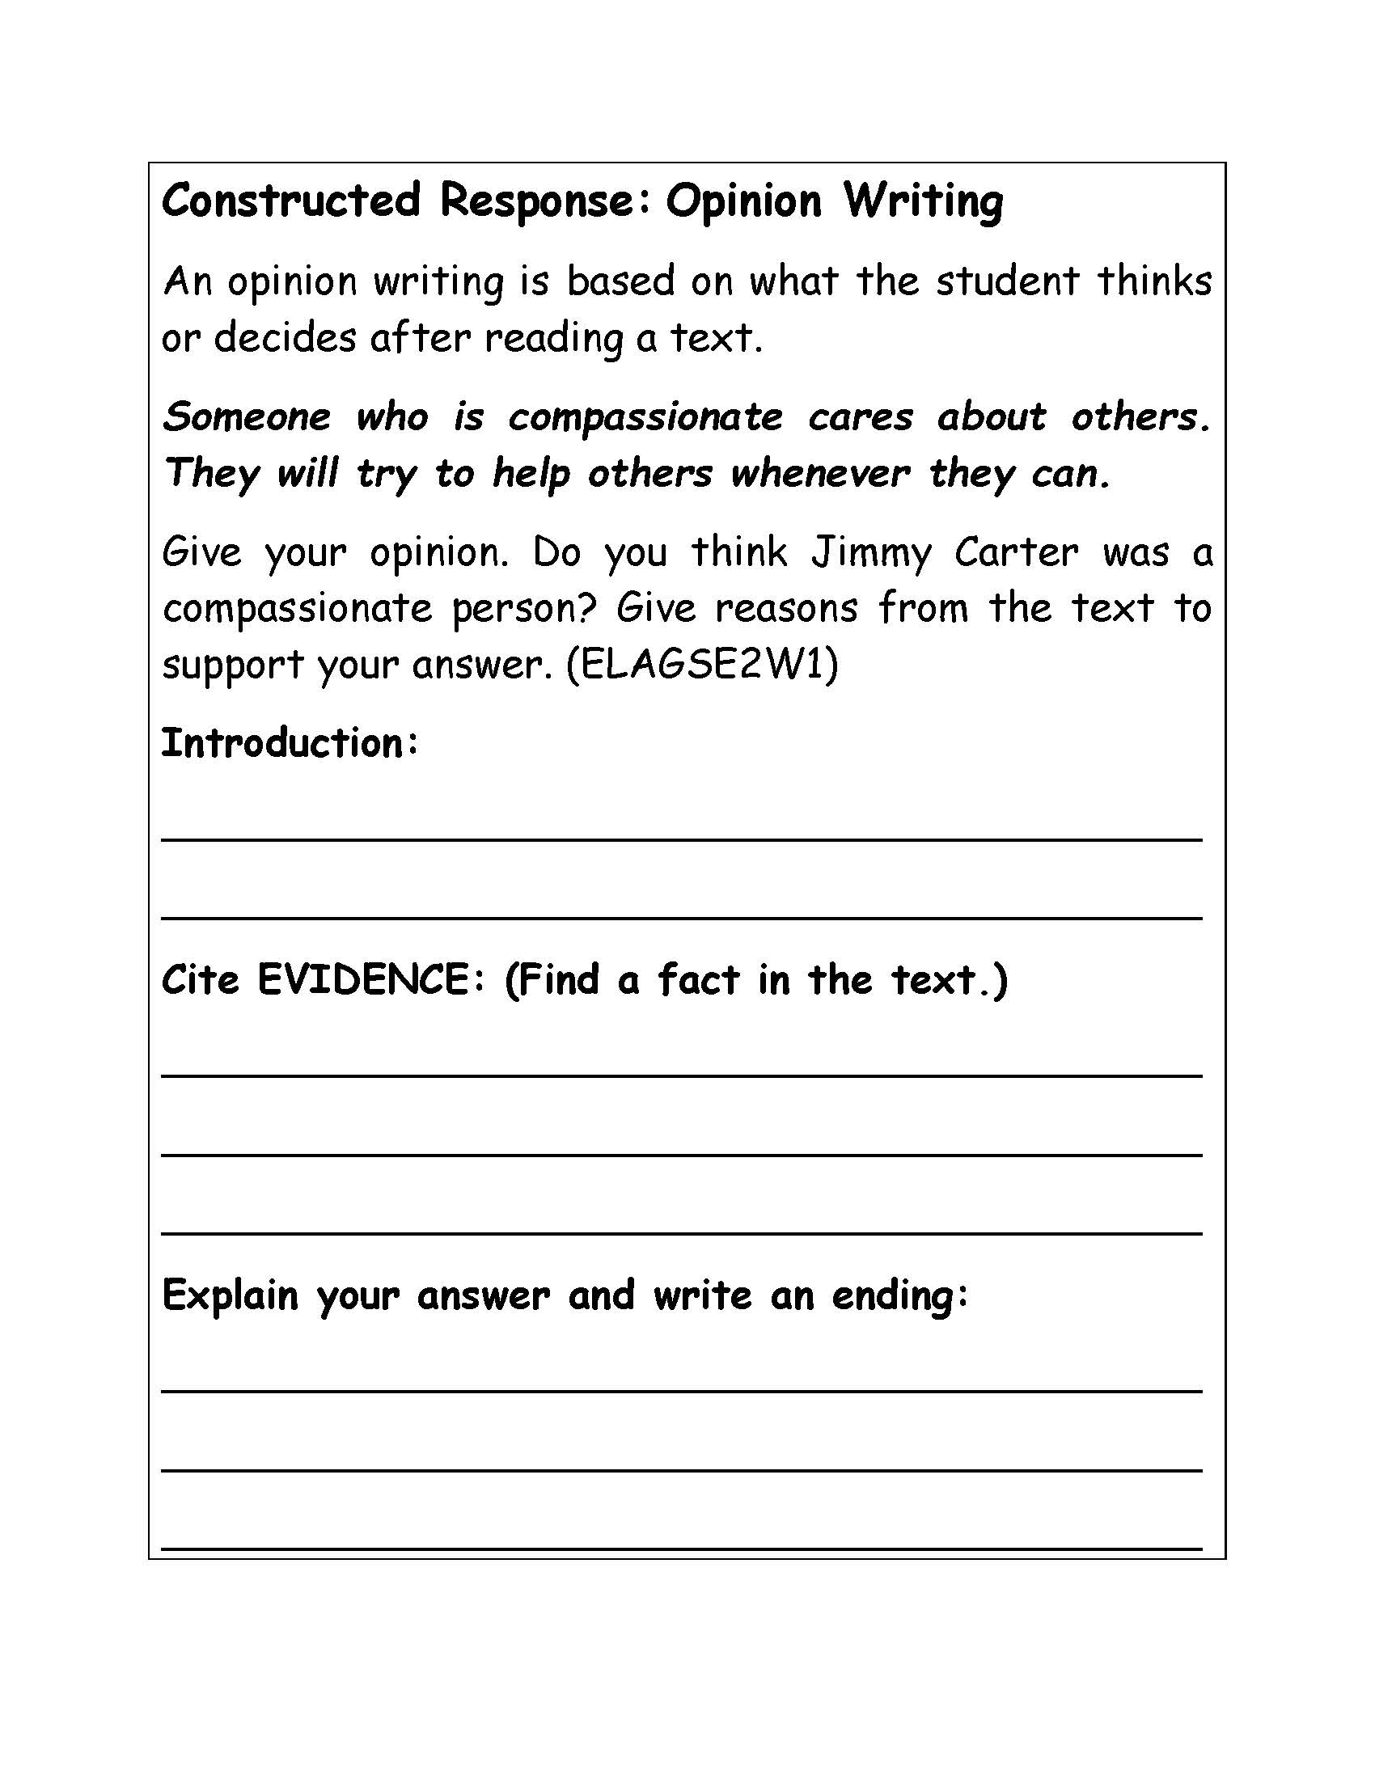
Writing
This is an opinion writing prompt – Students will give their opinion and locate evidence in the text to support their answers. This is imperative for students to practice the different writing genres as they advance into third grade.

Slide 101
The Second Grade Book – flip book format for you to use in your classroom
Pull up the Second Grade book here:
All Social Studies Demo | Concisecurriculum

Slide 102
The Assessment Guide

Slide 103
The Assessment Guide
Vocabulary Assessment
Reading Comprehension Assessment
Cloze Passages
Writing Assessment/Prompts
Fluency

Slide 104
The Assessment Guide
Writing about meaningful content serves multiple purposes :
learning/synthesizing the SS content
practices different writing genres

Slide 105
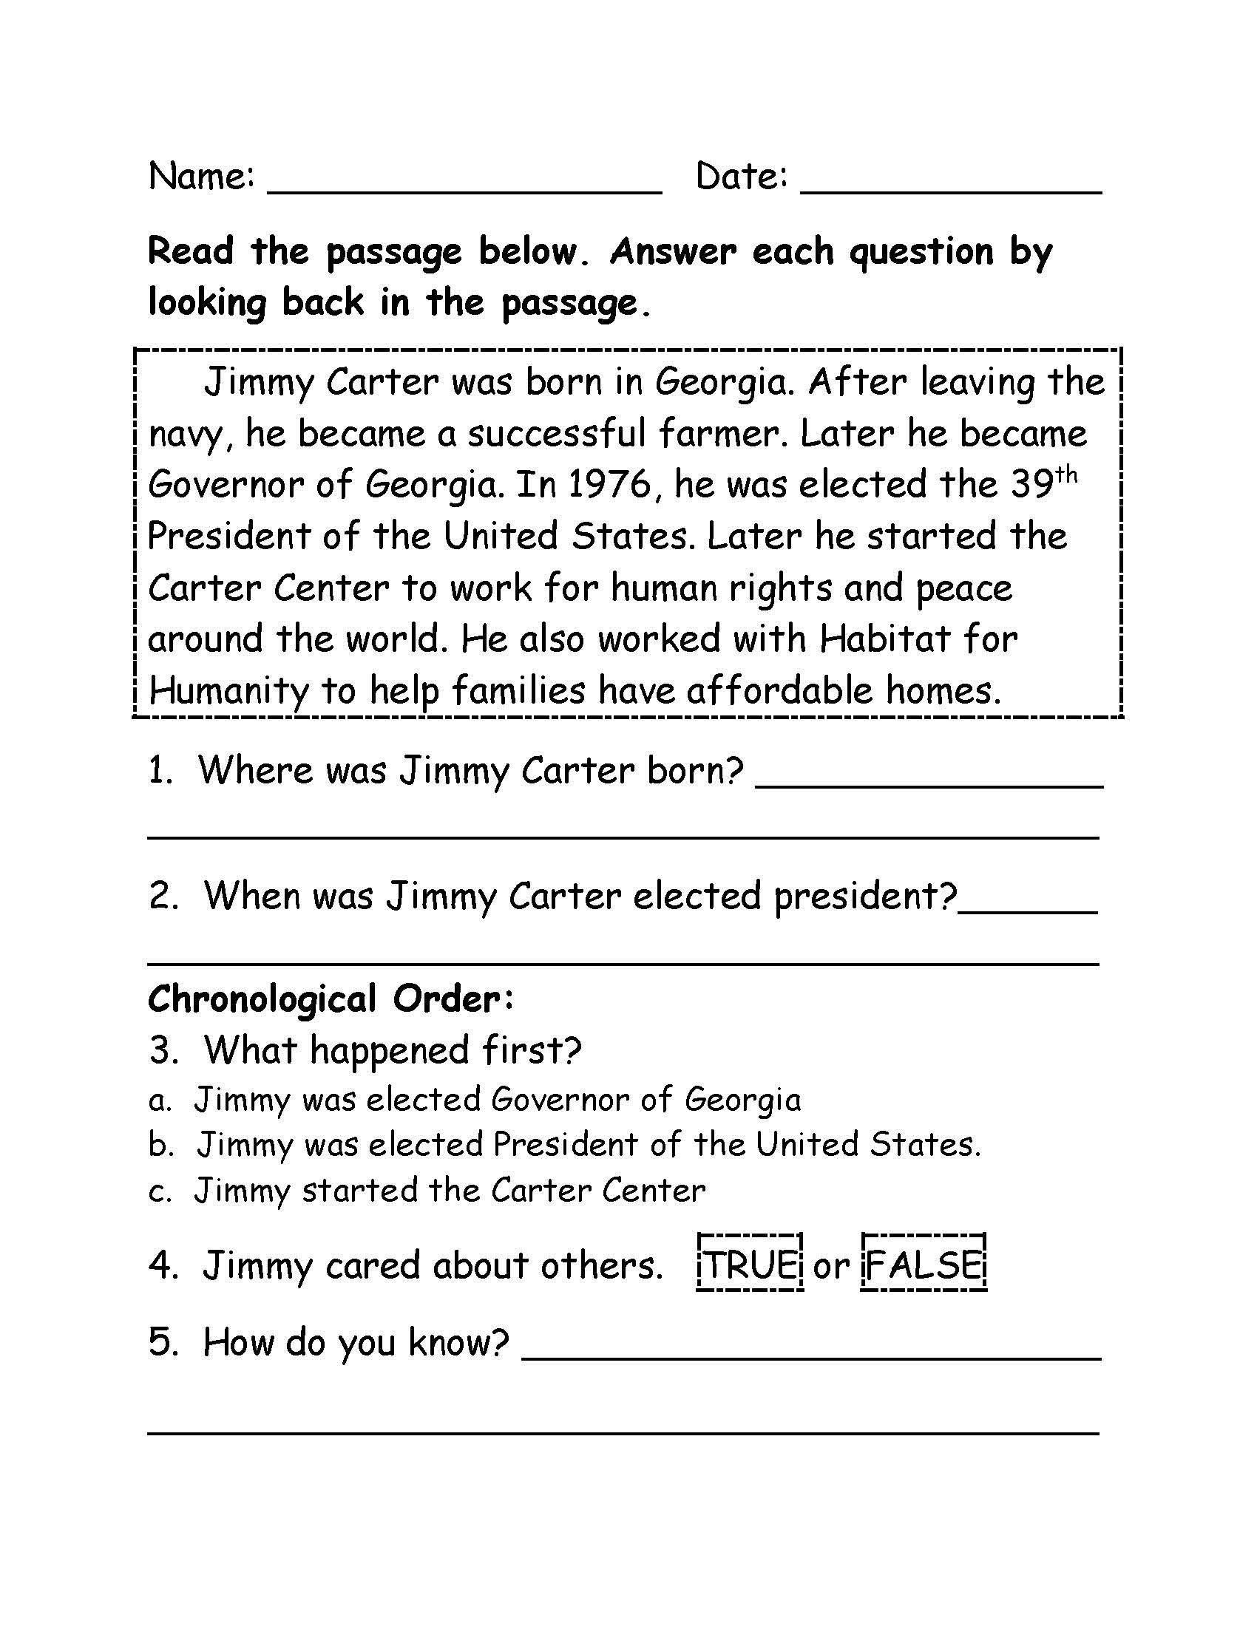
The Assessment Guide
Reading Comprehension
Assessment
Assesses reading comprehension of relevant
non-fiction texts
Chronological Order – this question leads to a
discussion of chronological order and students will
make a decision on which event happened first
TRUE or FALSE – students will make a decision
about what they read
How do you know? Students will write an
explanation of their answer.

Slide 106
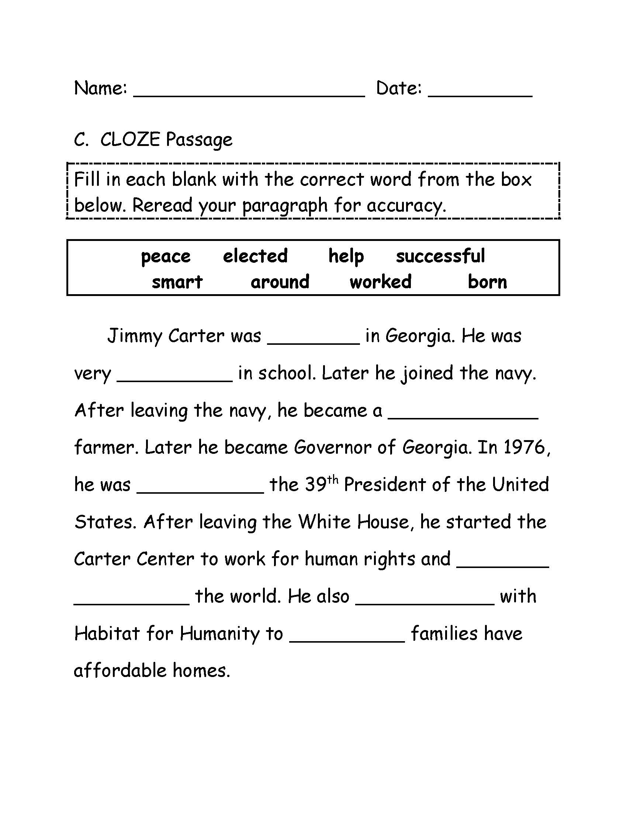
The Assessment Guide
Vocabulary Assessment
CLOZE passages plus
other forms of vocabulary
assessments in the assessment
guide

Slide 107
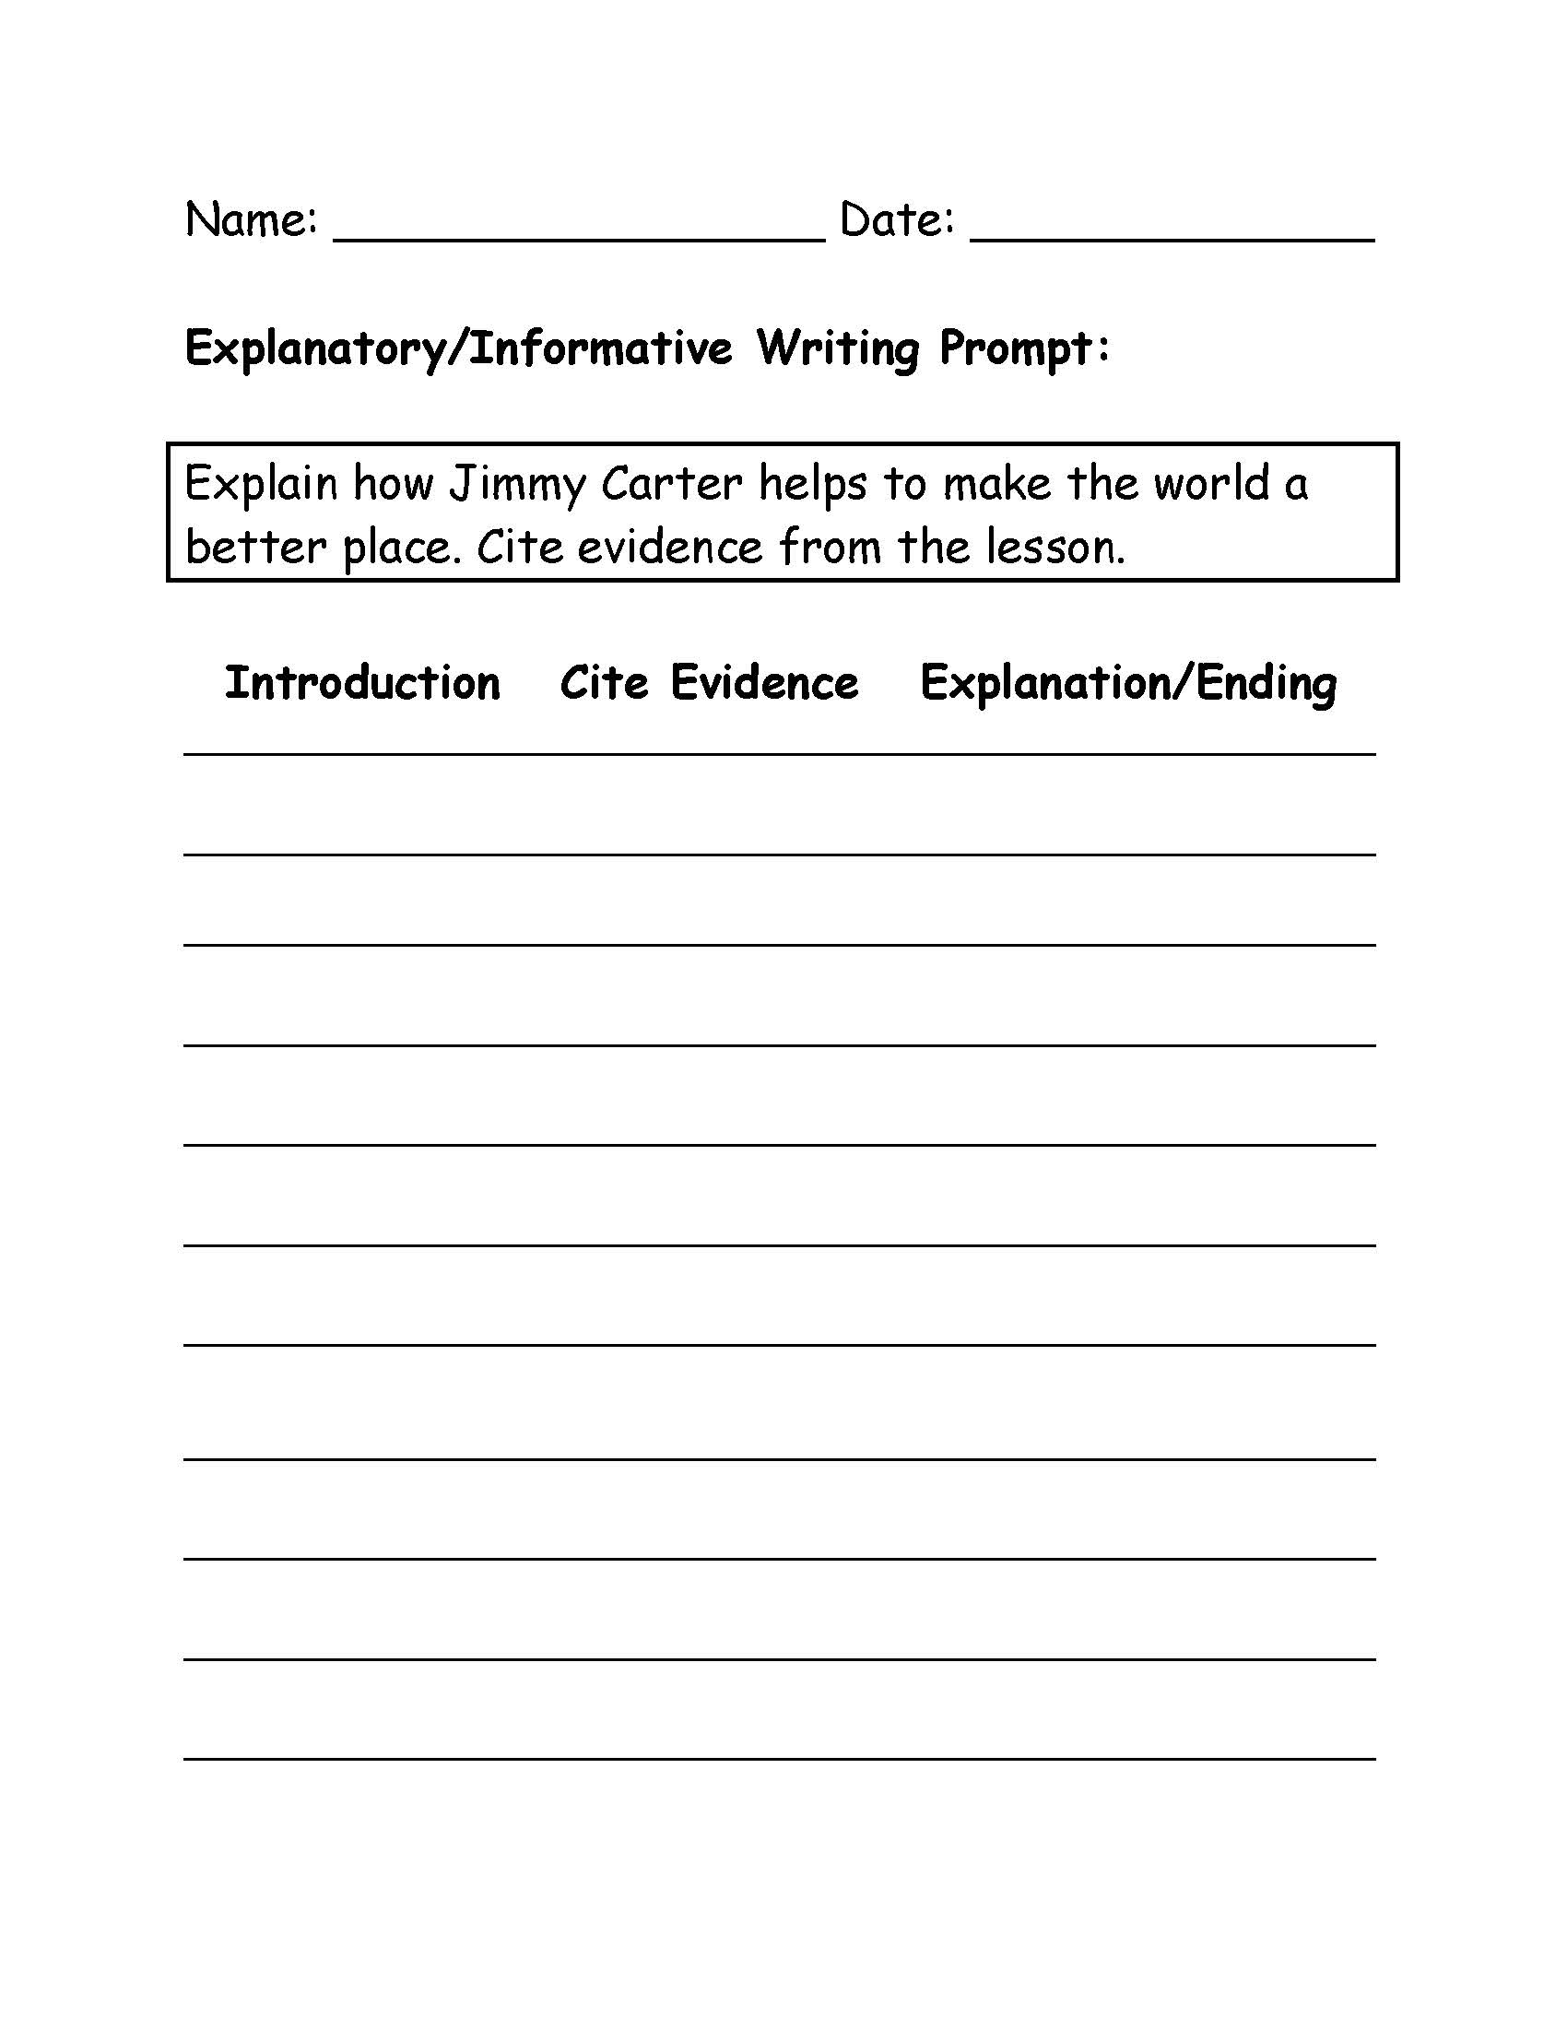
The Assessment Guide
Writing Assessment
Explanatory/Informative
Writing Prompt
Students need to WRITE!
Writing helps ingrain the
topic in their memory. Current
research shows writing connects
both sides of the brain which promotes
learning and memory.

Slide 108
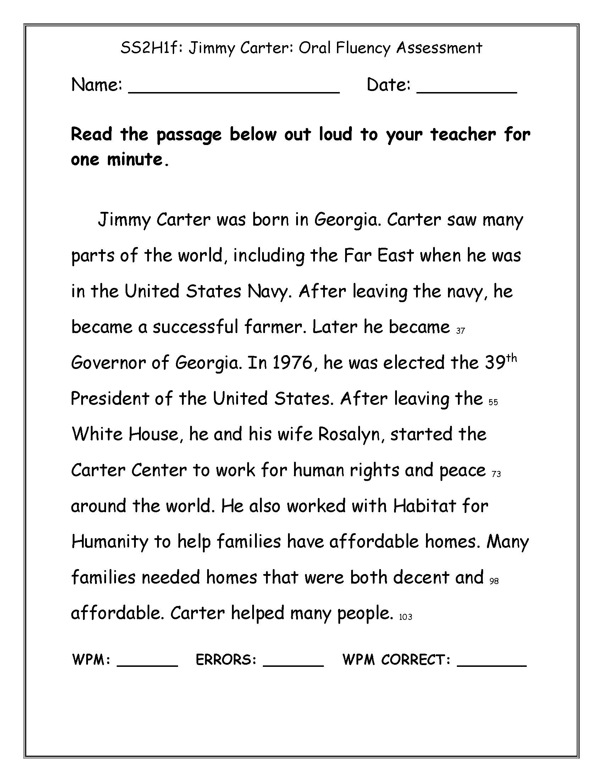
The Assessment Guide
Oral Fluency Assessment
Oral fluency - assessing words from
a relevant text about –
Social Studies standard/non-fiction
passage (this helps reading become
automatic) – students see
words over and over while
learning Social Studies content.

Slide 109
Let’s Look at Another Lesson
Pages 185- 190 Scarcity and Opportunity Costs
Let’s take a look at this lesson. What ELA skills are used when reading about Scarcity and Opportunity Costs?
Even when learning about economics we are TEACHING READING!

Slide 110
Let’s Look at Another Lesson
Pages 185- 190 Scarcity and Opportunity Costs
Ask teachers to discuss with their table/shoulder partner the different ELA skills in this lesson.
How does this support the Science of Reading?
How does this support teaching reading during the content area of instruction?

Slide 111
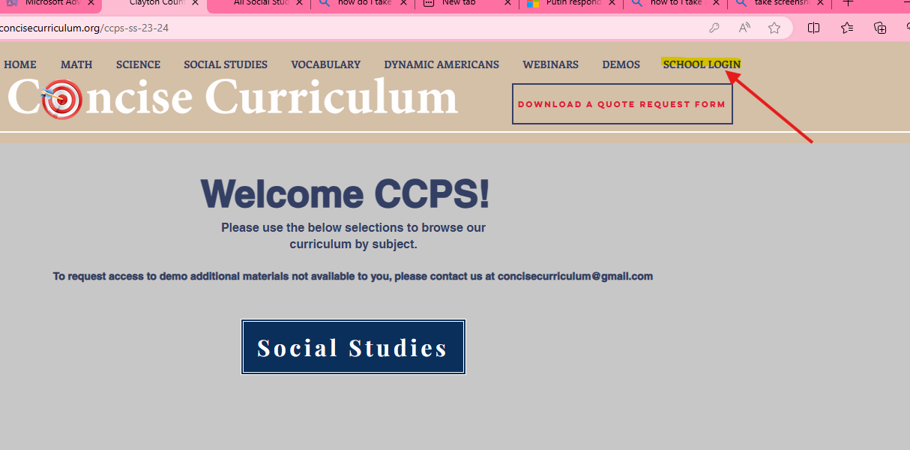
Learn More About Our Program
Visit us at: https://www.concisecurriculum.org/school-login
* Click “CCPSSS2324 ”
* Guest Area: CCPSSS2324
* Click “Social Studies” Tab
* Select grade level book option

Slide 112
6-10 words about Concise Curriculum and the Science of Reading
On the back of your 6-10 word writing about the Science of Reading write about how you can use Concise Curriculum in your classroom to help support your learners in all aspects of reading.
*Take a few minutes to ask a few teachers in the class to share their thoughts.

Slide 113
24-25 School Year
Each school already has/will have a book for each student in your grade level.
You will also have a code to view/pull up the book on your Smart board/tv in your classroom.

Slide 114
CODE for the Concise Social Studies Books
(K-5)
www.concisecurriculum.org/school-login
Click “Clayton County”
Guest Area Log In
CCPSSS2324
Then Click “Social Studies”

Slide 115
County Requirement for EACH Session
Scroll to the correct slide for the session.
Teachers will scan the QR code and SIGN OUT and fill out the feedback questions.

Slide 116
County Sign Out Session 1
Please sign out for county documentation.

Slide 117
County Sign Out Session 2
Please sign out for county documentation.

Slide 118
County Sign Out Session 3
Please sign out for county documentation.

Slide 119
County Sign Out Session 4
Please sign out for county documentation.

Slide 120
Learn about Joan Sedita’s Writing Rope
If time permits
https://youtu.be/EGg9zxzBJdo?si=EPp_GAaqrGopiJOc

Slide 121
Thank you for your time and consideration!
Contact Us
We provide prompt, personalized customer service.
Please contact us with any questions you may have!
(404) 732-4193
(678) 371-9361
concisecurriculum@gmail.com
Fax: (770) 631-3746

